Slide 1
Virtualization
The common theme of all virtualization technologies is the hiding of technical detail, through encapsulation.
Virtualization creates an external interface that hides an underlying implementation, e.g. by multiplexing access, by combining resources at different physical locations, or by simplifying a control system.

Slide 2
Installing a Virtual machine
Will first install VirtualBox as hypervisor
Base OS is Windows 7
Guest OS will be Ubuntu 12.04.1

Slide 3
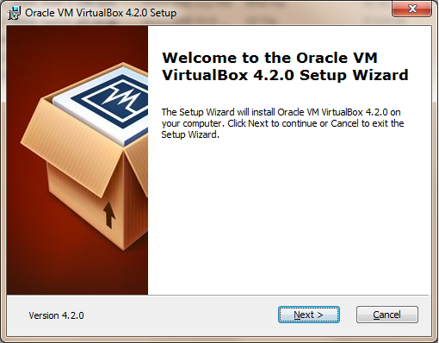
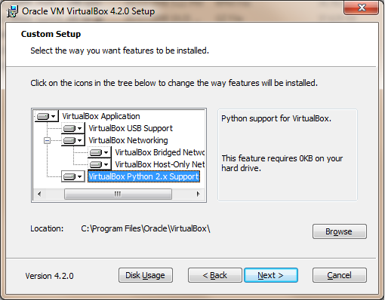
Installing VirtualBox

Slide 4
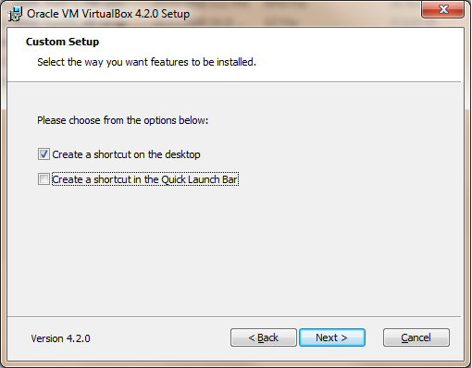
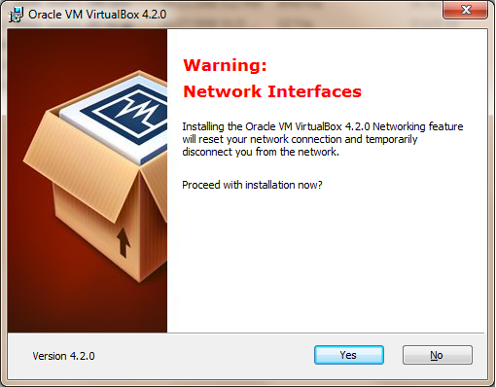
Installing VirtualBox

Slide 5
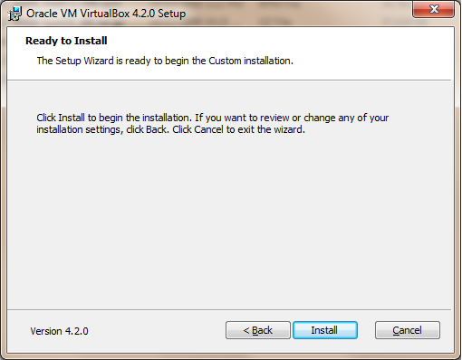
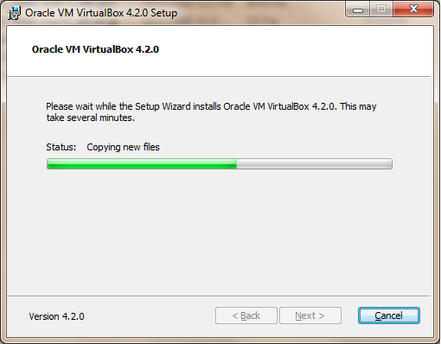
Installing VirtualBox

Slide 6
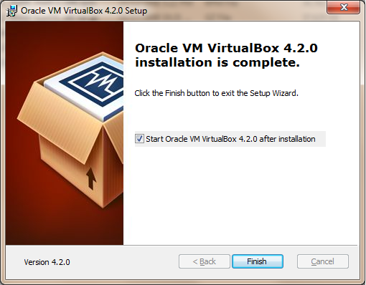
Installing VirtualBox

Slide 7
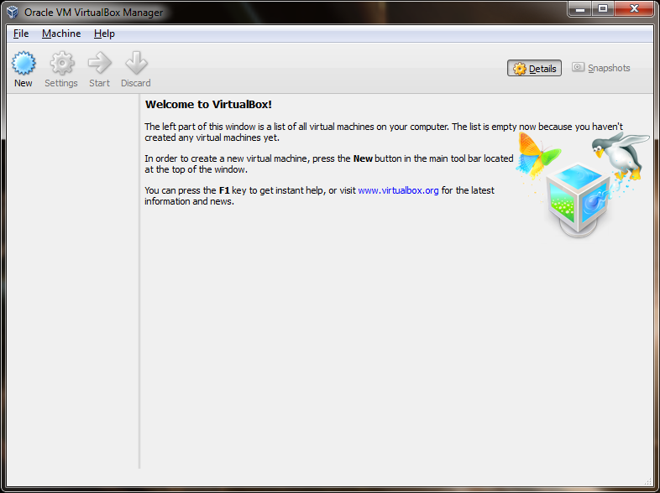
Installing Ubuntu VM

Slide 8
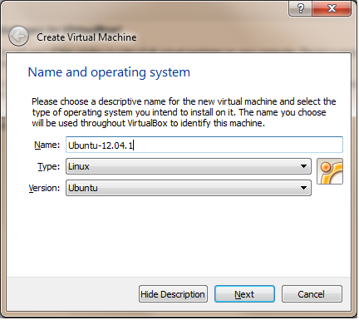
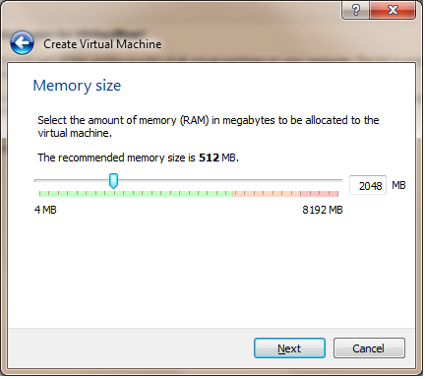
Installing Ubuntu VM

Slide 9
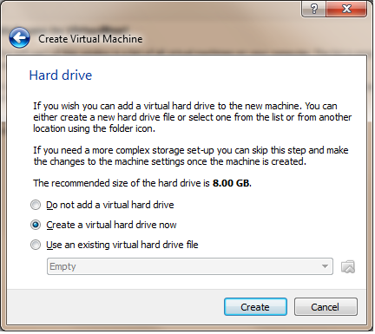
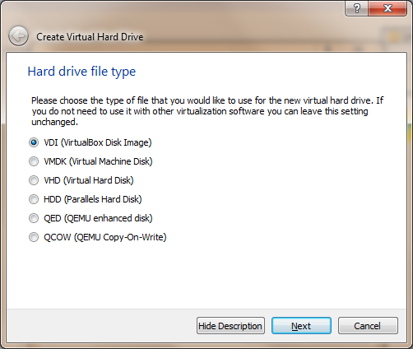
Installing Ubuntu VM

Slide 10
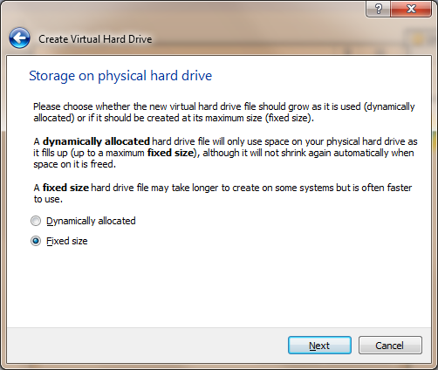
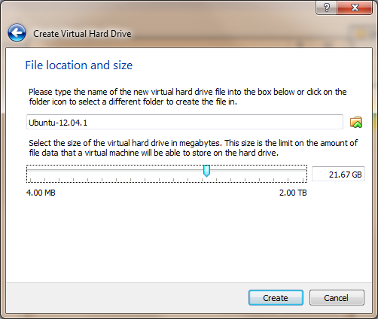
Installing Ubuntu VM

Slide 11
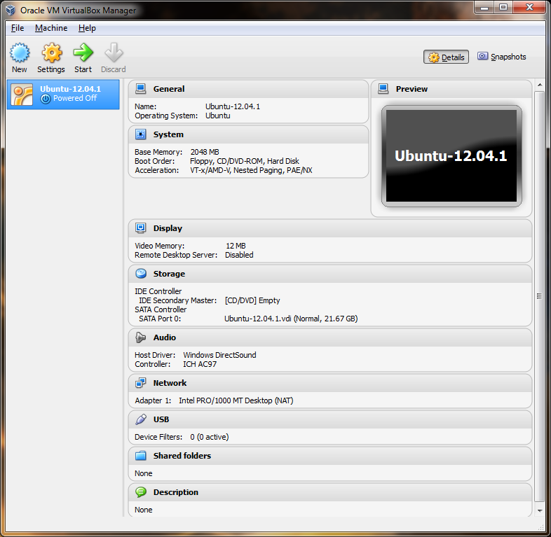
Installing Ubntu VM

Slide 12
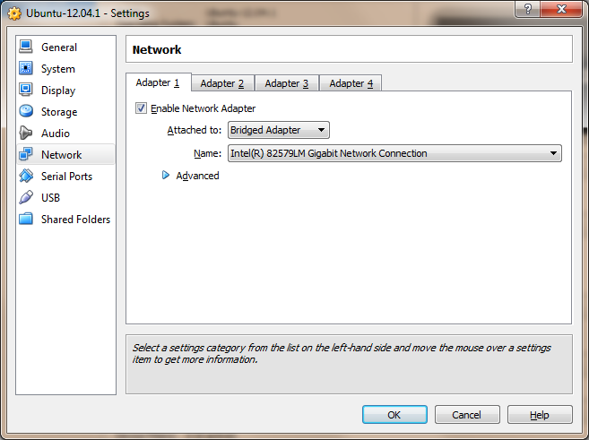
Installing Ubuntu VM

Slide 13
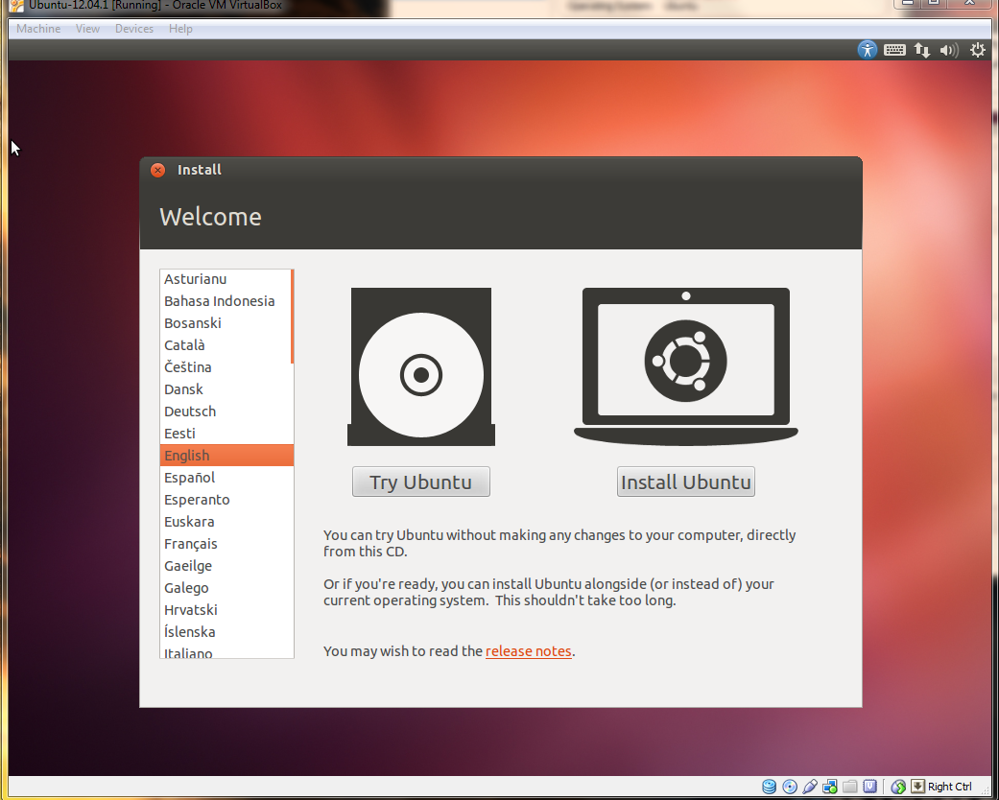
Installing Ubuntu VM

Slide 14
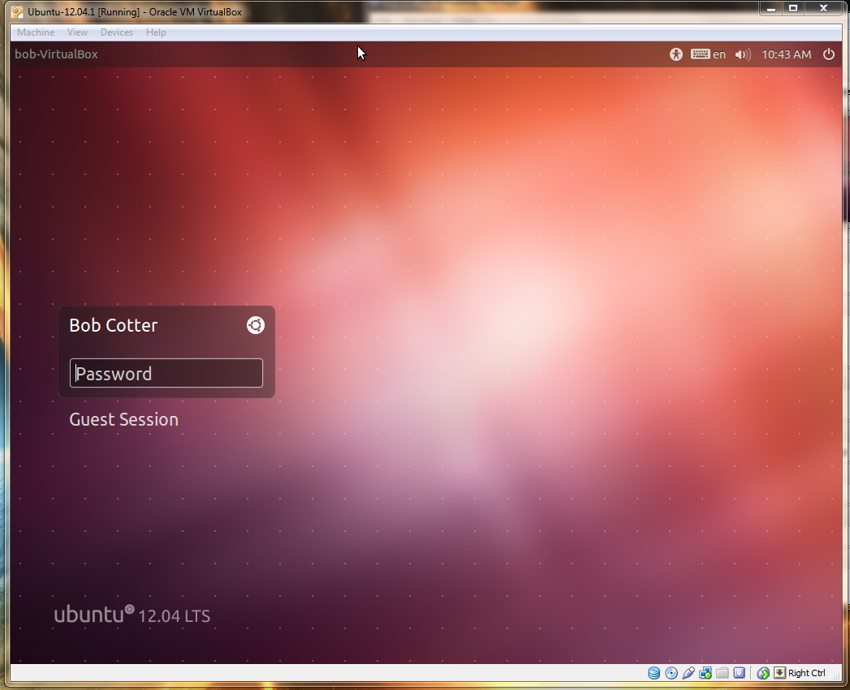
Installing Ubuntu VM

